Slide 1
Core Task Project And Social Emotional Learning
Developed by Washoe County School District Downloaded from CASEL’s District Resource Center
Aaron Grossman, Torrey Palmer, Sam Shoolroy

Slide 2

Essential Questions
How can we…
    foster teacher/student understanding of Social Emotional Learning through a lens of the ELA instructional shifts and the close reading strategy?
    seamlessly integrate SEL outcomes into the Common Core classroom?

Slide 3

Objectives
  Identify Social Emotional Learning Strategies that support our students as they work with the Common Core
  Using data from the Core Task Project and CTP/SEL, collaboratively develop a model of teacher support for close reading

Slide 4
Reflection…
Considering observations and ruminations from the past week…
Read the article, Got Grit? By Thomas R. Hoerr
http://www.ascd.org/publications/educational-leadership/mar12/vol69/num06/Got-Grit%C2%A2.aspx
Do you see a fit between Hoerr’s article and SEL?

Slide 5

Exploring The Five Anchors of SEL
Self-Awareness
Responsible Decision
Making
Self-Management
Social
Awareness
Relationship Skills
Notes:
Part of SEL…
Read through handout on competencies

Slide 6

Take a Break!

Slide 7



CCSS Publisher’s Criteria
Annotate your text as
you read…
  Put a ? near parts of the
  text that are puzzling
  Put a * next to parts you
  think are important
  Put an ! next to parts that
  are new to you.
Notes:
Use text marking (annotation technique) for Pub Criteria

Slide 8

Elements of a Close Read

Slide 9
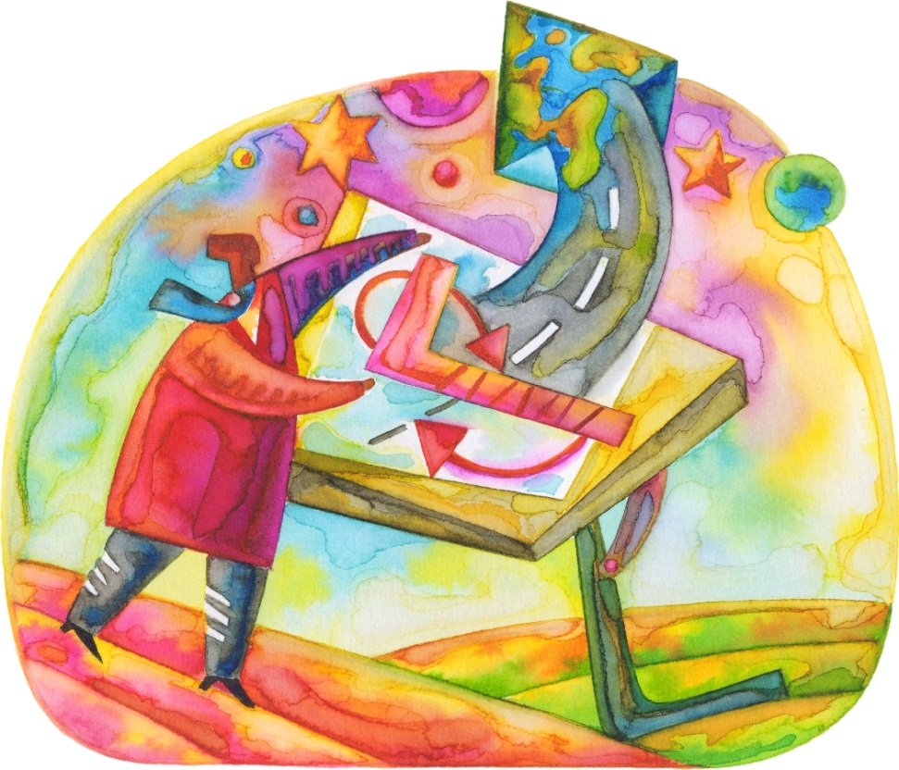
Collaborative planning with SEL Standards and Close Reading Exemplars
Notes:
Work in grade level/exemplar groups
Add supports that are scalable. Must be able to explain, teach, write, frame, structure…

Slide 10
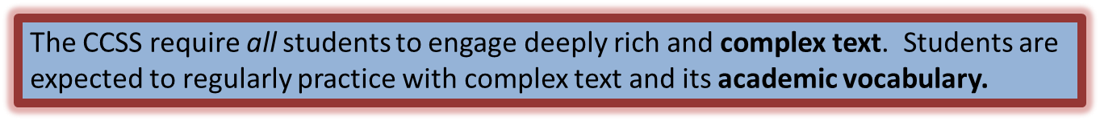
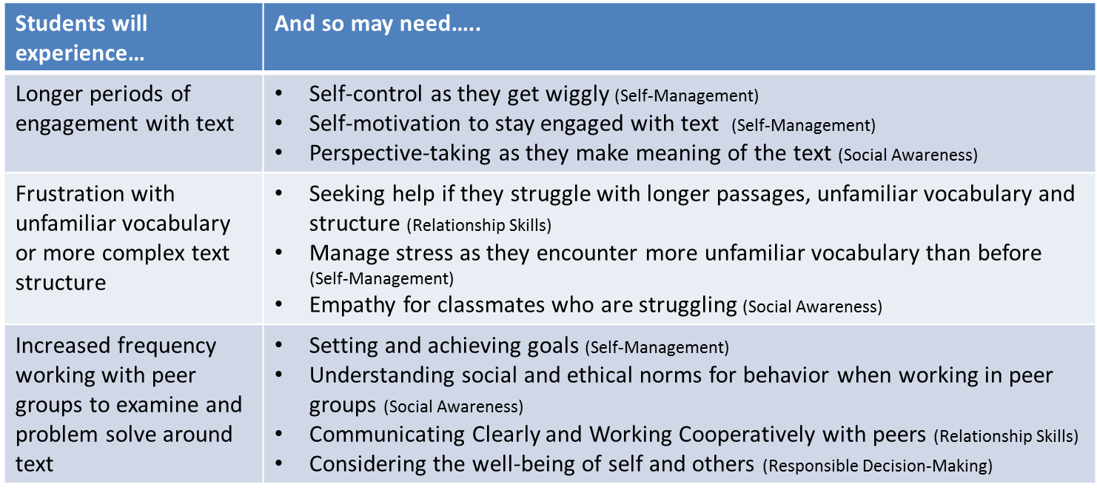
Text Complexity
Adapted from Chicago Public Schools

Slide 11
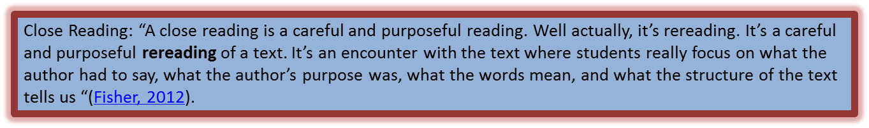
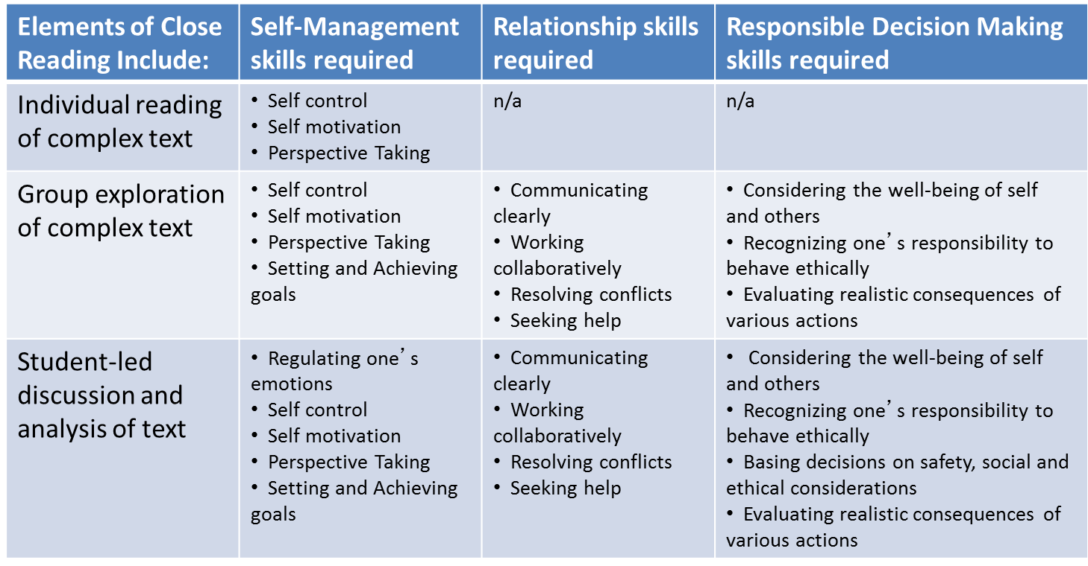
Close Reading
Adapted from Chicago Public Schools

Slide 12
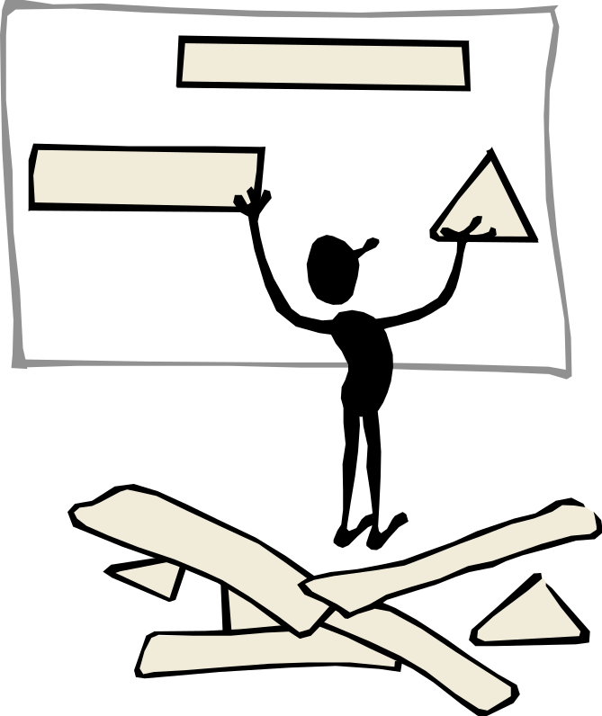
Share and Revise Plans…

Slide 13
Intention Partners
On your card write:
    One word to summarize how you are feeling
    Set an intention for implementation
Choose a partner to share your intention with.
    Record their name on your card.
    Discuss check in options.

Slide 14

For next time…
Implement your Close Read lesson with your students using SEL strategies.
Come prepared to share your experience with explicit references to SEL within your lesson plan.

Slide 15

Thank you!

