Slide 1
Where We Are with SEL
Monitoring School Progress and Planning for the Future
Developed by Washoe County School District Downloaded from CASEL’s District Resource Center

Slide 2
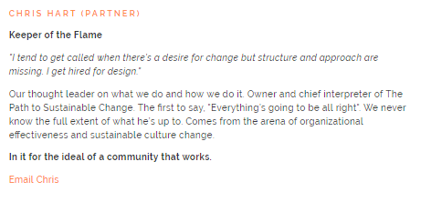


What’s Your REAL Title?

Slide 3

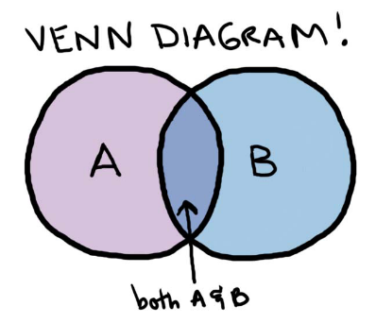

Future-Connectors-In-Chief
Get to Know You Survey:
https://backtoschool.panoramaed.com/7748E9/teachers/new
Step 1:
Step 2:
Step 3:

Slide 4
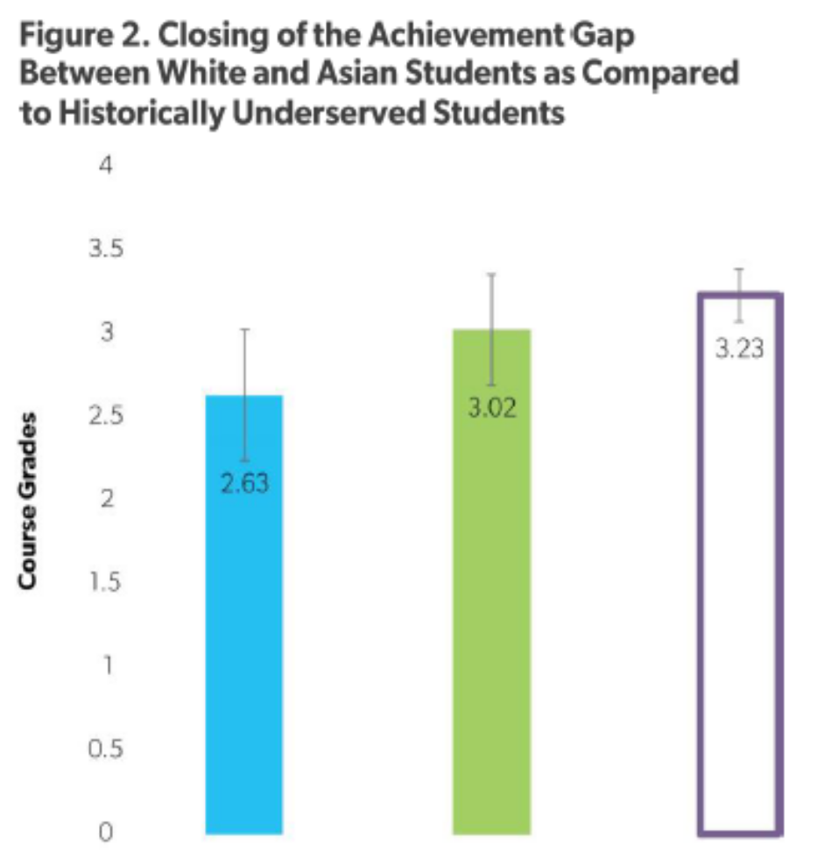
Didn’t affect students’ ratings of relationships, but when teachers saw commonalities with students, rated relationships more positively, particularly under-served students
When teachers saw similarities between self and students, achievement gap reduced by 60% (see Figure 2)
Control
Treatment
White/Asian (Both C&T)

Slide 5
Climate Survey Debrief

Slide 6
Learning Intentions
1
2
Decompose the data to find trends
3
Discuss how we can support the students and school to enhance school climate
Build our understanding of the purpose and intention of the Climate Survey

Slide 7
WCSD Climate Surveys
All students in grades 5 – 9 and 11
  Climate Survey (N = 11,566)
  Safety Survey (N = 11,822) (82%)
  Online only
All parents in district
  Paper or online
  N = 8,667 (61%)
All school staff in district
  Online
  N = 3,932 (68%)
Did you know?
We have 6 years of data from the three surveys!
Notes:
The Student Climate Survey is something that more than 20,000 students in our school district participate in every year since 2011. That means that almost 1/3rd of all the students in the district give us their feedback through this survey.

Slide 8
Some Patterns to Examine
Trends over time
Comparison to District OR a “like” school
Vertical Alignment: ES vs. MS vs. HS
Student vs. Parent vs. Staff Surveys
Don’t forget to ask for your school’s parent and staff comments! Email ldavidson@washoeschools.net
Notes:
There are many different ways to look at school climate data. In addition to what you see in this year’s report, consider looking at other trends in the data:
How have your scale scores changed from this year to previous years’? We encourage you to examine scale scores (total percentage agreement captions on the first page like “80% of staff agree that they have high expectations for all students”) rather than individual items over time, since those tend to be more reliable. Why do you think the scores have changed year over year? What other events or changes occurred during that year that contribute to the percentage difference?
Although we compare your school’s scores with the same school-level in the report, you might want to look at how your school compares to a “like” school. If you are a school that receives Title I funding, you may want to pull up reports for other Title I schools to compare. Or, if your school is implementing Social and Emotional Learning for the first time this year, you may want to look at another school that is also in their first year of implementation.
How do staff’ opinions change from elementary to middle to high school in your vertical? Do most staff feel more engaged in elementary schools vs. high schools? If so, why might that difference exist?
There are similar and/or identical items on the staff, student, and parent surveys. How do your staff’s beliefs about student drug use compare to students’ actual self-report of their own drug use? Are the reports similar or different?
All staff and parents were asked several open-ended questions about their school. However, because specific names and identifying information were included in some comments, they have to be de-identified before we can give them to you. There are hundreds of comments though, so please remember to request them from ldavidson@washoeschools.net so you can use this great information for action-planning at your school!

Slide 9

STAFF RESPECT AND COLLABORATION
INSTRUCTION AND PARENT INVOLVEMENT
STAFF-STUDENT RELATIONS
SAFETY
Fairness and Respect
Staff Collaboration
Early Release Wednesdays
Instructional Focus
Parent Involvement
Social-Emotional Learning
Staff Climate Survey
School Safety
Student Behavior
Staff-Student Relationships
Expectations of Success
Notes:
These are the types of things we ask staff about on the Staff Climate Survey. You’ll notice many of the topics are similar between the staff, student, and parent surveys.

Slide 10
STUDENT-STAFF RELATIONSHIPS
CULTURE OF RESPECT
SOCIAL AND EMOTIONAL SKILLS
EDUCATION ATTITUDES
Adult Caring
Academic Support
Student Respect
Staff Respect
Student Climate Survey
Utility of Education
Self-Efficacy
Participation
Student Engagement
Self-Awareness
Social Awareness
Self-Management
Relationship Skills
Decision-Making
Notes:
These are the types of things we ask students about on the Student Climate Survey. These are all things that have been found to strongly relate to whether students come to school and engage and their academic achievement (how well they do on tests and in their classes).

Slide 11
FEELINGS OF SAFETY
RISK-TAKING BEHAVIORS
VIOLENCE ON SCHOOL PROPERTY
DRUG/ ALCOHOL ATTITUDES
Safety In/Out of School
Safety Procedure Knowledge
Drugs
Alcohol
Skipping Class
Bringing Weapon
Student Safety Survey
Parent Attitudes
Peer Attitudes
Student Attitudes
Fighting
Teasing/Rumors
Sexting/Electronic
Property Damage
Notes:
These are the types of things we ask about on the Student Safety Survey. Before we can ever expect students to focus and do well in school, we have to ensure that they are safe, comfortable, and welcomed at our schools.

Slide 12
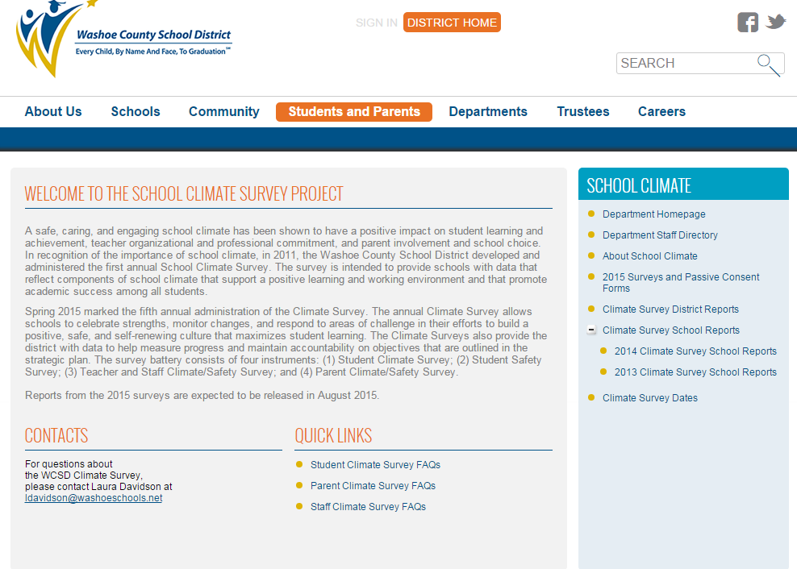
http://www.washoeschools.net/Page/866
Notes:
Here is where YOU can find your school’s survey reports. The link is at the top.

Slide 13
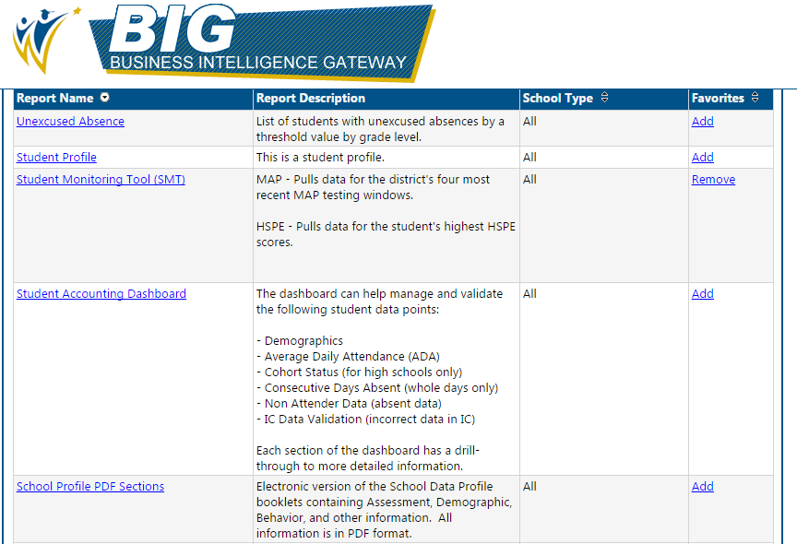
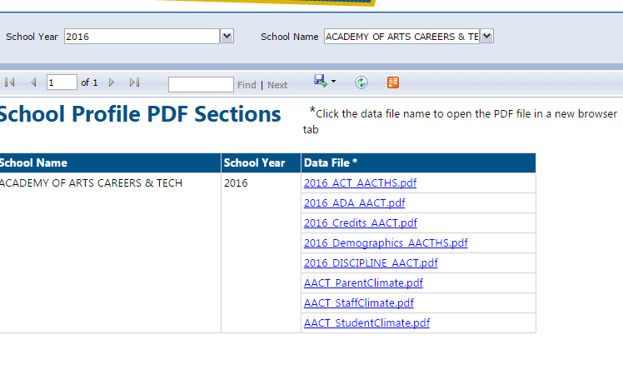
Notes:
Can also find the reports on BIG

Slide 14
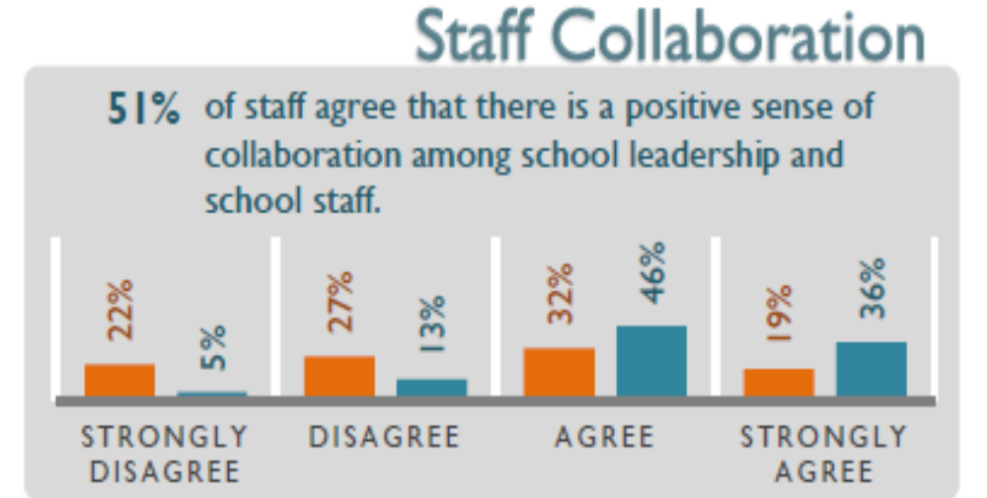

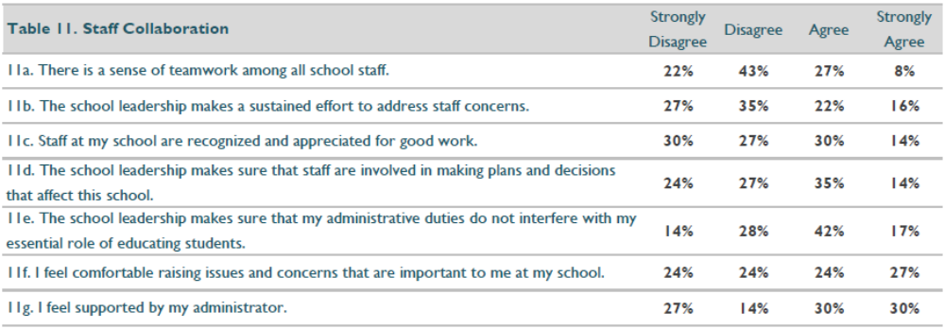
Notes:
[You can replace these with your own school’s data. But, it’s nice to show snapshots from your data or print out the reports so everyone can see the same data. Ideally, you want to look at the graphs on the front page of the report, and then dig into the scale more deeply by looking at the corresponding table. The scale is more reliable because the number is based on all the questions, but it’s also nice to look at the actual questions in the scale and what is high or low. Using the snapshot tool in Adobe Acrobat, you can take pictures just like this from the reports that you can then copy and paste into this sample powerpoint]

Slide 15

Notes:
Laura

Slide 16
Your School Reports
Culture and Climate: Questions that assess how your school feels to all members of the learning community (circle them)
Teaching SEL: Questions that assess how we are doing teaching SEL skills (star them)

Slide 17
Here’s What,
So What,
Now What?
Debriefing the data

Slide 18
Here’s What: Top 3
What does our data say about how our school feels to all members of the learning community?
What does our data say about how SEL implementation is going?
Action: 3 wins, 2 question, 1 potential concern
Notes:
10 min.
Participants review data independently first, then draw their attention to specific areas or trends you would like them to focus on.
Ask them to respond to the questions on the slide verbally in their group and record their thoughts on the handout.

Slide 19
So What?
What feedback can you offer about certain trends?
What other data can we bring to shed light on these trends?
Why is this data important?
Notes:
10 min.
Ask participants to respond to the questions on the slide verbally in their group and record their thoughts on the handout.

Slide 20
Now What?
What action steps can we take as a school community to further our SEL goals?
  Where do we want to be?
  How will we know when we have gotten there?
Notes:
10 min.
Ask participants to respond to the questions on the slide verbally in their group and record their thoughts on the handout.
Remind them that the purpose of the discussion is to review the data as a community in order to work together to improve the school climate. Keep everything light and positive!

Slide 21
Tools We Have
Behavior data, attendance data, engagement surveys, achievement data
Teacher Rating Survey
Student Self-Report Surveys
55 Item Staff Survey
Notes:
10 min.
Ask participants to respond to the questions on the slide verbally in their group and record their thoughts on the handout.
Remind them that the purpose of the discussion is to review the data as a community in order to work together to improve the school climate. Keep everything light and positive!

Slide 22
Using the 55-Item
Staff Survey to Measure SEL Implementation
WCSD User Guide 2016

Slide 23
What Is the 55-Item
SEL Staff Survey?
Assesses Staff’s Perception of SEL Implementation in 6 Key Areas (those most linked with schoolwide sustainability):
  Establishing a Shared Vision for SEL
  Assessing Resources and Needs
  Providing Professional Learning
  Adapting Evidence-Based Programs
  Integrating SEL Schoolwide
  Using Data for Continuous Improvement

Slide 24
Why do the 55-Item
SEL Staff Survey?
Helps measure staff-wide buy-in for SEL
Helps measure changes year-over-year in classroom implementation of SEL
Can be used as evaluation measure in SPP
Linked to CASEL School Guide, with hundreds of resources for improving areas of challenge
Can be linked to student data to measure relationship between SEL implementation and student outcomes.

Slide 25
When to Administer Staff Survey
Your Site’s Decision
1. Pre/Post Option (2x a year):
  Beginning of Year (Sept 1st to Sept 30th)
  End of Year (April 3rd to April 28th)
2. Pre-Only Option (1x a year):
  Beginning of Year Only (Sept 1st to Sept 30th)
3. Post-Only Option (1x a year):
  End of Year Only (April 3rd to April 28th)

Slide 26
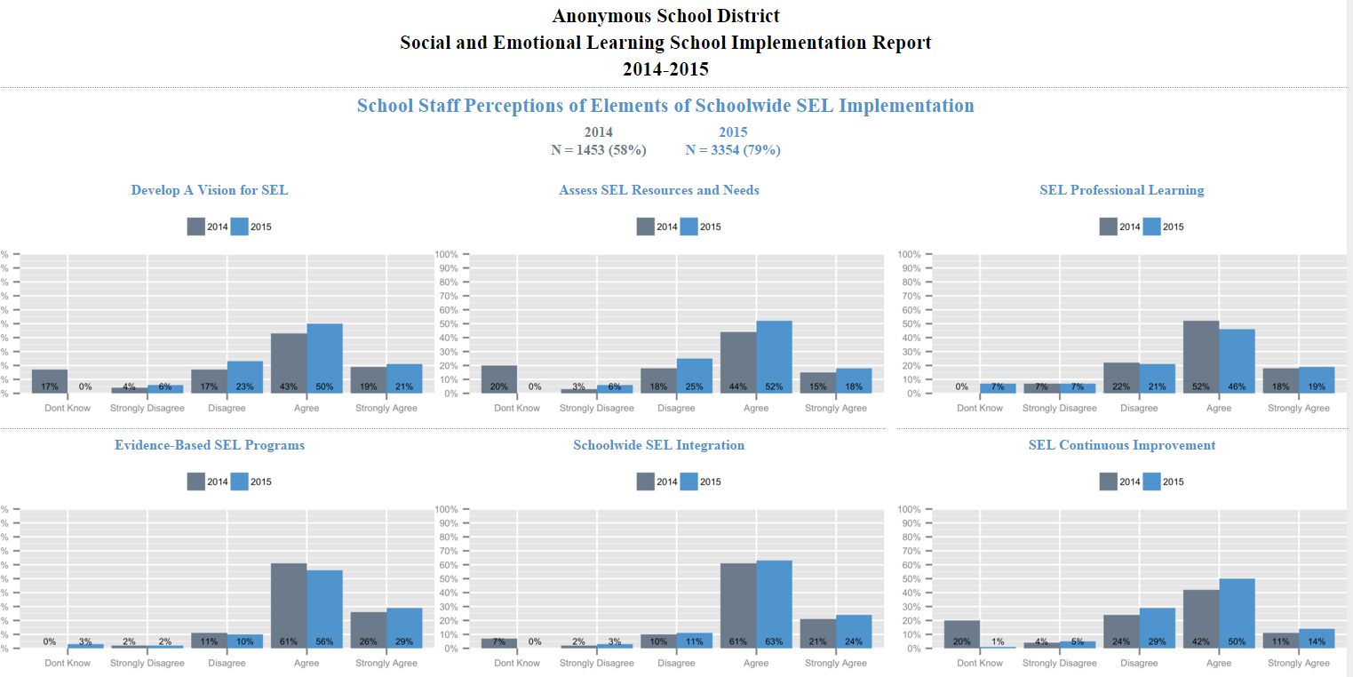

Slide 27
Thank you!
Email Laura Davidson at ldavidson@washoeschools.net for any questions about SEL data tools!

